Slide 1

Lecture 25.2
“Big data”
in genomics experiments
Nicola Romanò nicola.romano@ed.ac.uk

Slide 2
Learning objectives
At the end of this you should be able to:
Define “big data” in the context of biomedical research
Discuss the issues associated with big data
Describe a typical pipeline of genomic sequencing
Notes:
<number>

Slide 3
Big data – an historical perspective
What is “big data”?
“Big data is a simple way of referring to data sets whose size grows beyond the ability of software and hardware tools to manage, capture, and process in a reasonable timeframe. Big data is where the amount of data is so massive that it becomes very difficult to control.”
Iannarelli and O’Shaughnessy, 2015
Term (in its current form) popularized in 2005 by Roger Mougalas from O'Reilly Media…
… but the problem has been around much longer.
Notes:
<number>

Slide 4
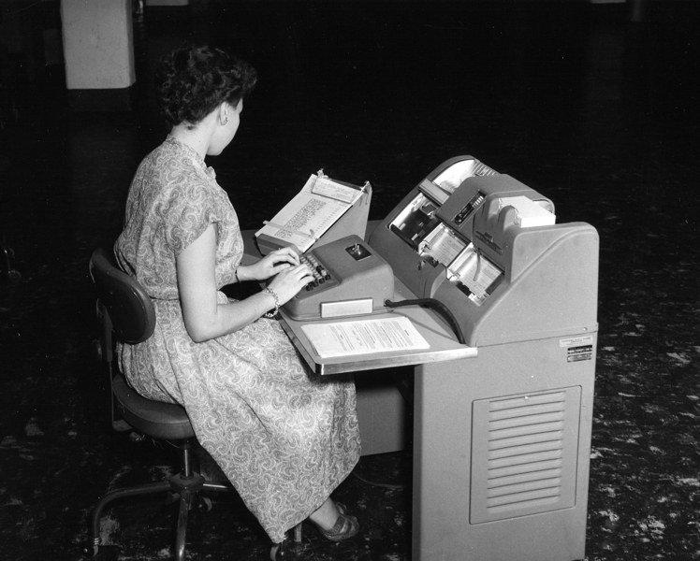
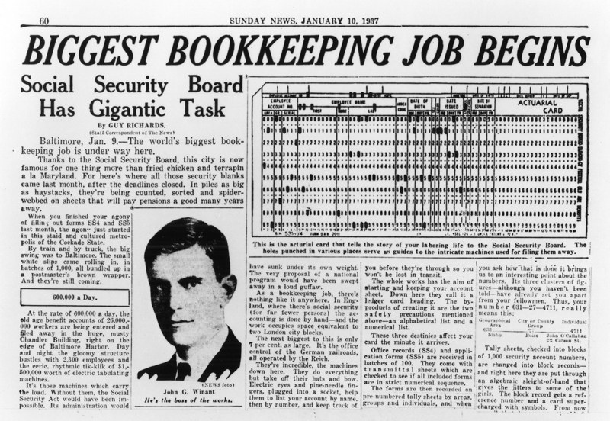
Big data – an historical perspective
Early “big data” management in the 1930s – source Wired
In 1937 the US government enacted the Social Security Act
Data from 26 million Americans >3 million employers
IBM developed punch card readers specifically for the job
Notes:
<number>

Slide 5
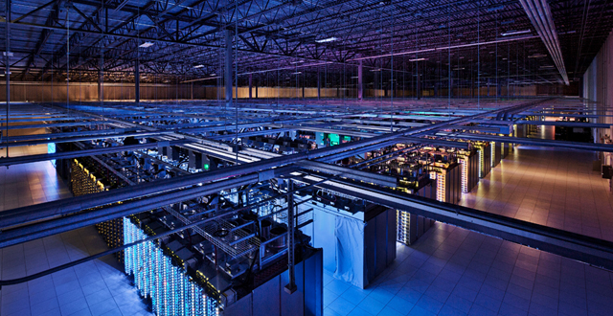
Big data and computing technology
The sheer volume of data produced today requires
A lot of space (virtual and physical) to store data
Large computing power to analyse data
Enhanced security to protect data
One of Google’s data centres – Source Google
Notes:
Google: >2.5 million servers in 2016
<number>

Slide 6
Big data in biology
Biology has been affected as well
From “traditional”, hypothesis-driven experimental strategies to large scale exploratory studies
Notes:
<number>

Slide 7
Deduction vs induction
Improve
Known theory
Theory
New hypothesis
Hypothesis
Test with experiment
Find patterns in data
Confirm or discard hyp.
Collect data (a lot of!)

Slide 8
Big data in biology
Biology has been affected as well
From “traditional”, hypothesis-driven experimental strategies to large scale exploratory studies
“Big data” is found in many domains of biomedical research
Genomics
Proteomics
Imaging
…
Notes:
<number>

Slide 9
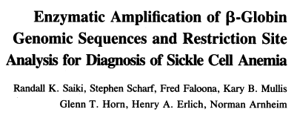
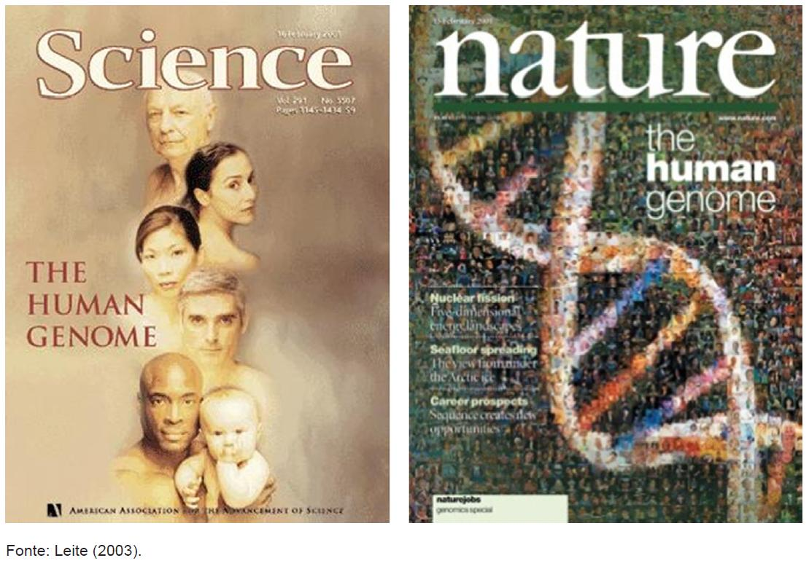
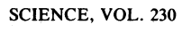
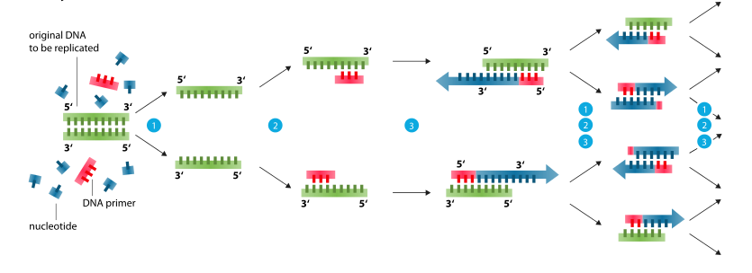
New technologies in genetics
Enormous efforts to sequence the human genome contributed to a big technological push in technologies related to genetics.
Venter, J. C. et al.
Science 291, 304–1351 (2001).
International Human Genome Sequencing Consortium, Nature 409, 860–921 (2001).
PCR – source: Wikipedia
1985 – Kary Mullis develops PCR
2001 – The human genome is sequenced
Notes:
<number>

Slide 10
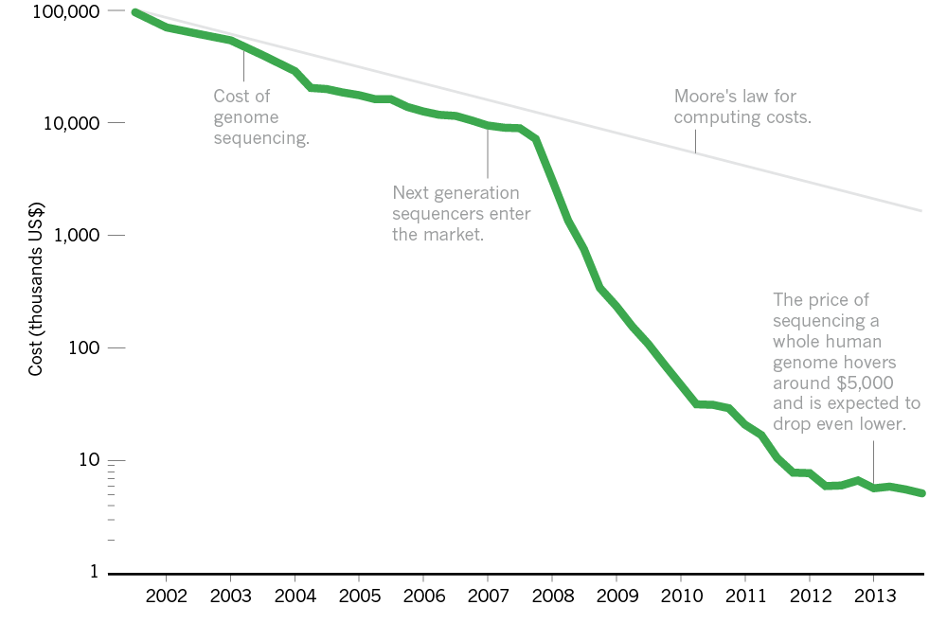
New technologies in genetics
Introduction of next generation sequencing (NGS) made sequencing price drop faster then predicted. Today you can sequence a genome for <$1000.
Nature News, 19/3/2014
Notes:
Human genome project costed ~$100M
<number>

Slide 11
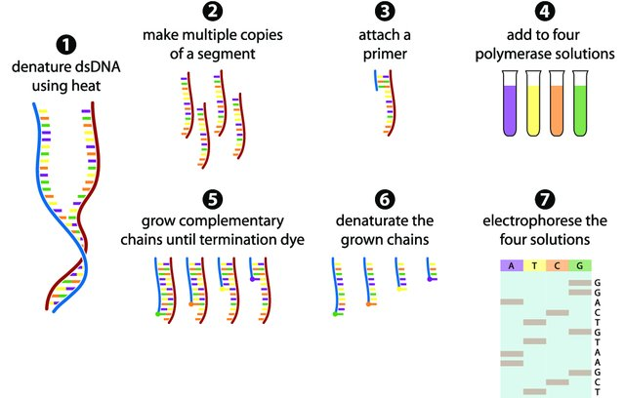
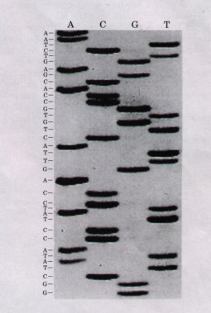
Traditional Sanger sequencing
Based on PCR using “terminator nucleotides” (analogues that can be incorporated in DNA, but cannot have another nucleotide attached)
Gauthier, 2007
Notes:
<number>

Slide 12
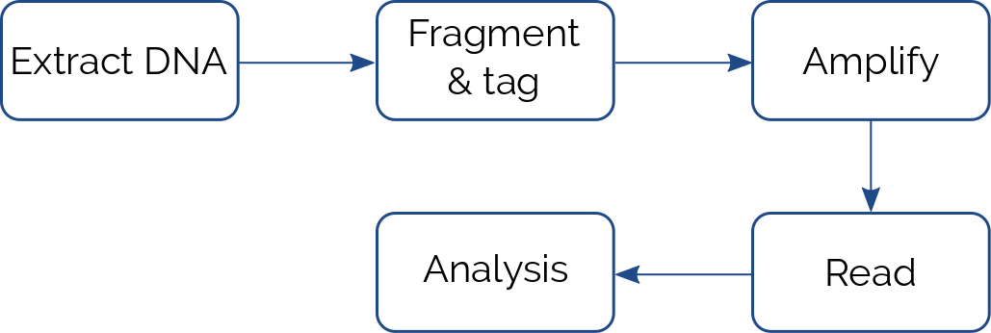
Next generation sequencing
Also called “massive parallel sequencing”. Improved speed and efficiency, reduced costs.
In most cases based on using microfluidics platform
Generally reads small fragments of DNA or RNA (150-300 bp)
Each fragment is called a “read”
State-of-the art machines can sequence up to >30M reads/hour
Notes:
~8000 reads/second
<number>

Slide 13
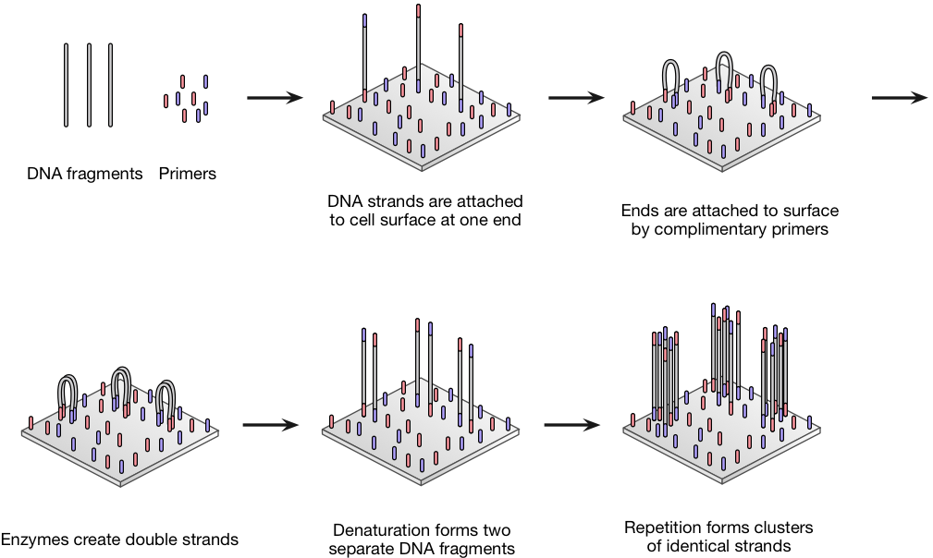
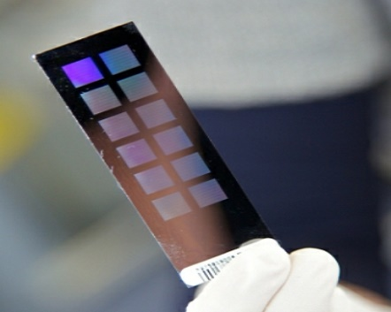
Illumina sequencing
In Illumina sequencing amplification is obtained by “bridge method”
Source: atdbio
Notes:
Adapters can also be used to identify samples
<number>

Slide 14
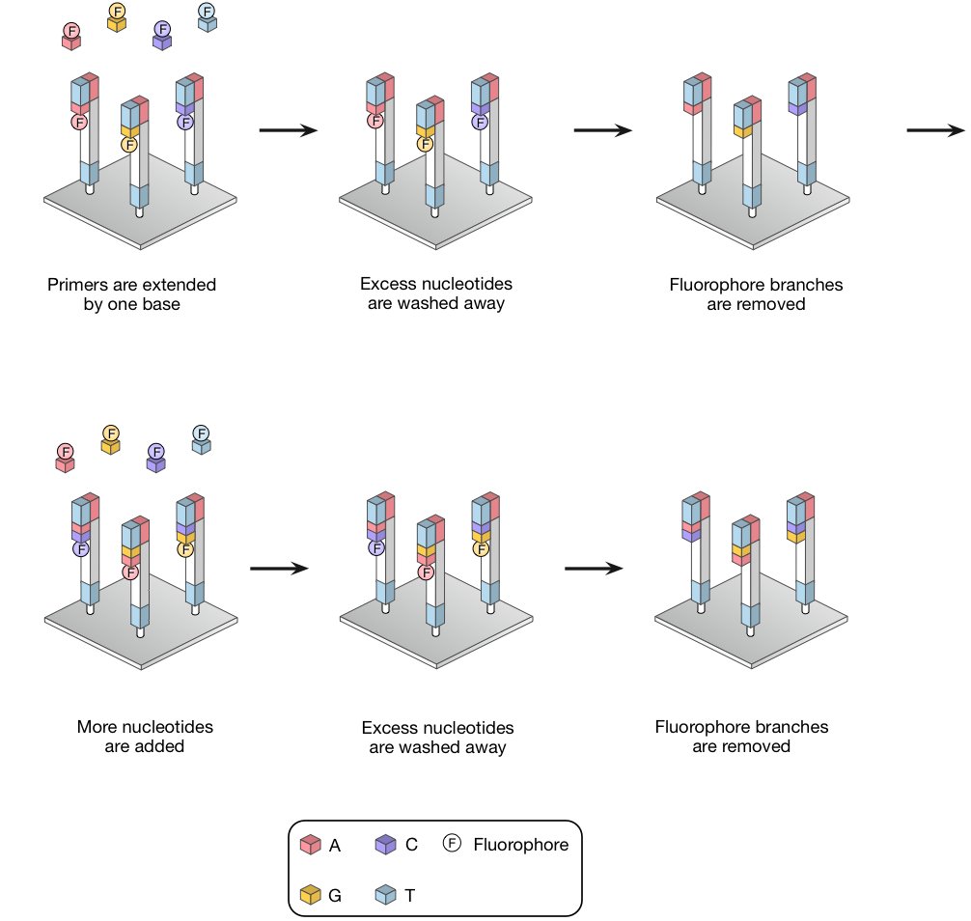
Illumina sequencing
Sequencing by synthesis
Source: atdbio
Notes:
<number>

Slide 15
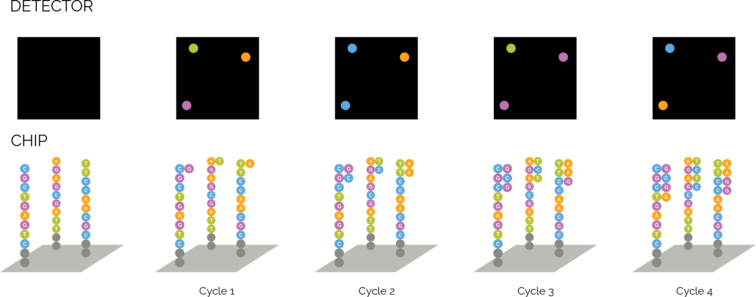
Illumina sequencing
At each step a picture with the spots corresponding to each cluster is taken
Notes:
<number>

Slide 16
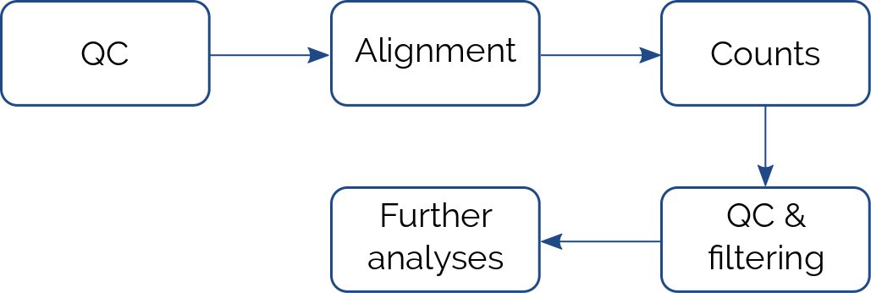
Bioinformatics analysis
The next step is to analyse the data
Data needs to be aligned to the genome and counted
 | S1 | S2 | S3 | S4
G1 | 120 | 0 | 30 | 34
G2 | 85 | 22 | 15 | 0
G3 | 0 | 0 | 2 | 88
G4 | 150 | 230 | 223 | 743
… | … | … | … | …
G20000 | 45 | 23 | 55 | 11
Notes:
<number>

Slide 17
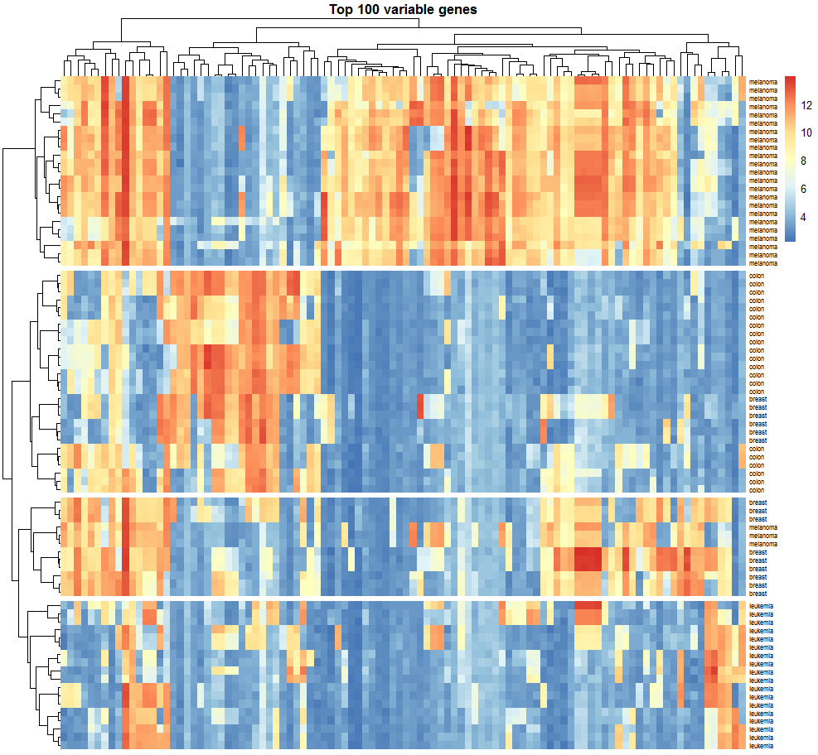
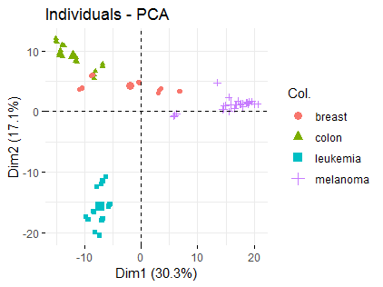
Bioinformatics analysis
Visualization techniques
Heatmaps and clustering, PCA - see Workshop 7!
Notes:
<number>

Slide 18
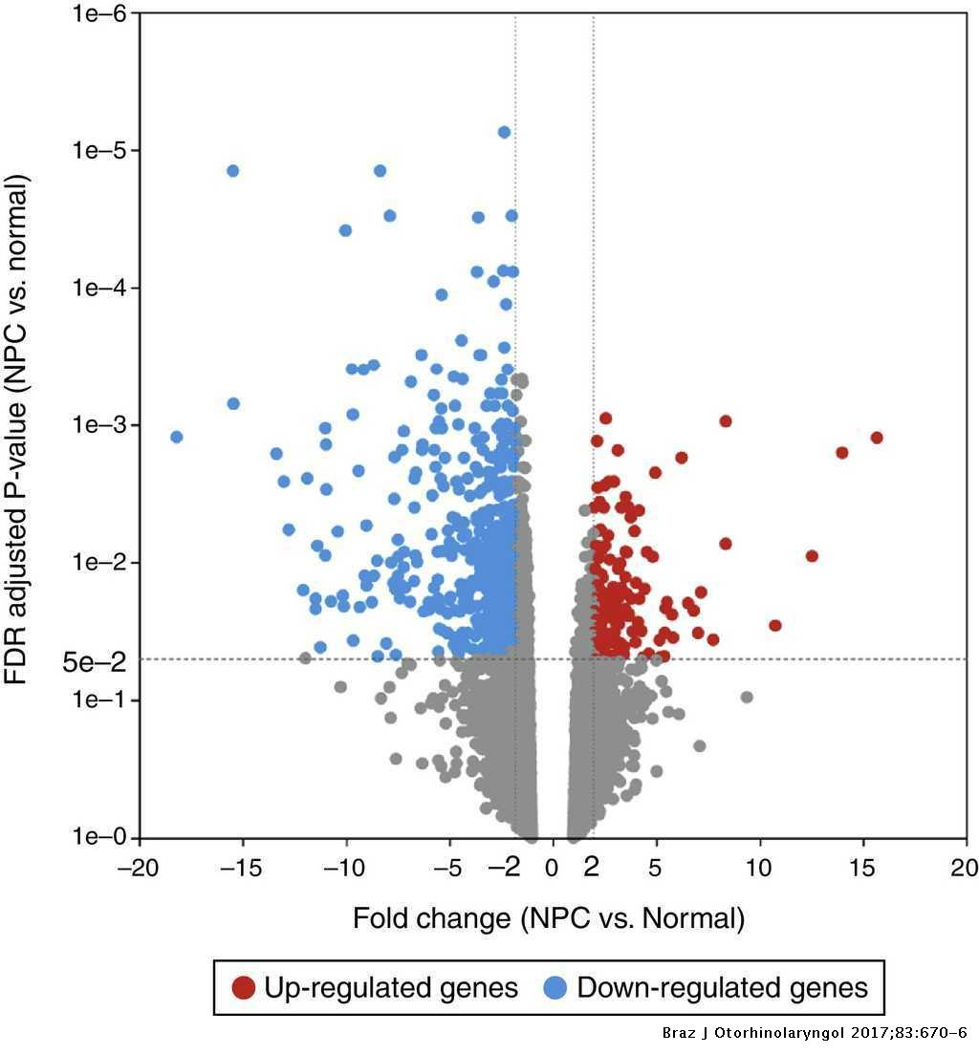
Bioinformatics analysis
Differential expression analysis
Finds genes under-/over-expressed between two samples
Considers fold change and adjusted p-value
Useful to find targets for further analysis
Jiang, 2016
Notes:
<number>

Slide 19
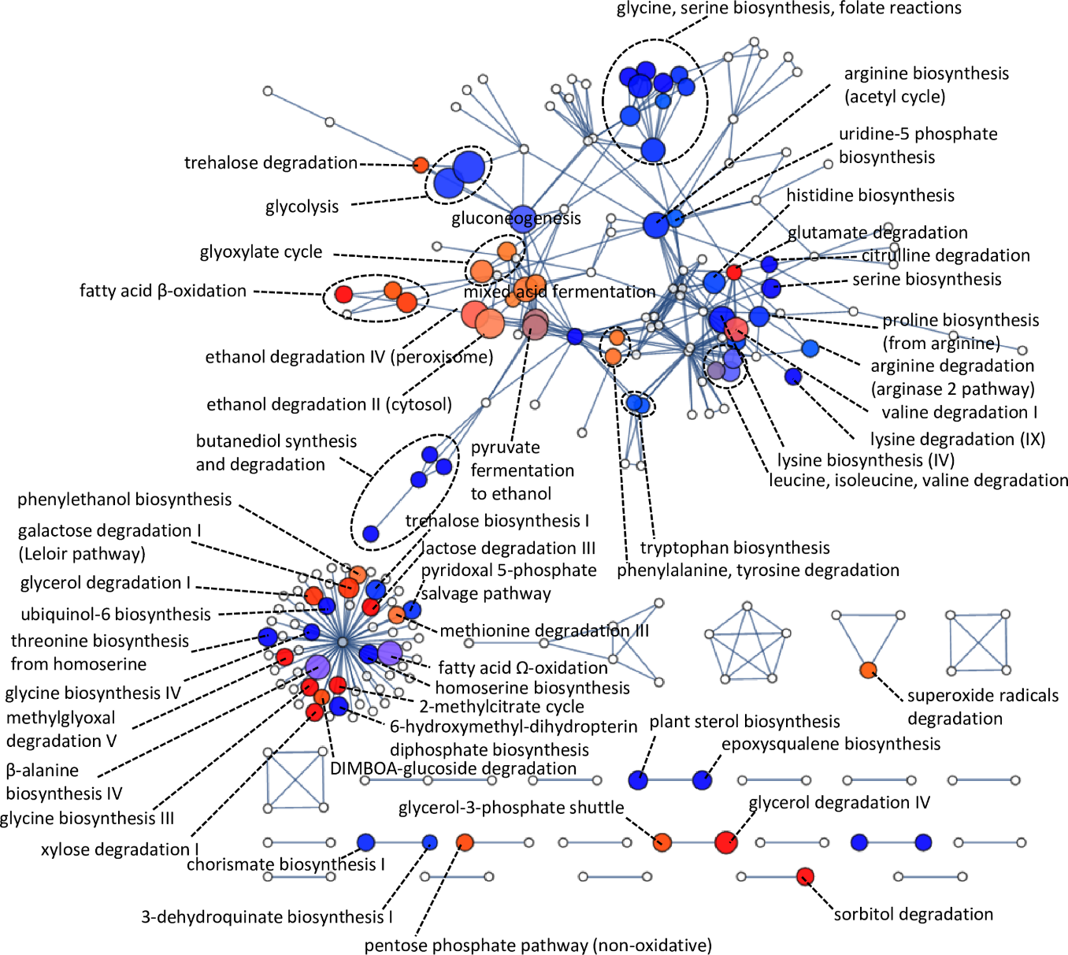
Bioinformatics analysis
Pathway analysis
Finds molecular pathways enriched in the sample
Genes can be mapped to function e.g. through GO annotations
Schabort, 2016
Notes:
<number>

Slide 20
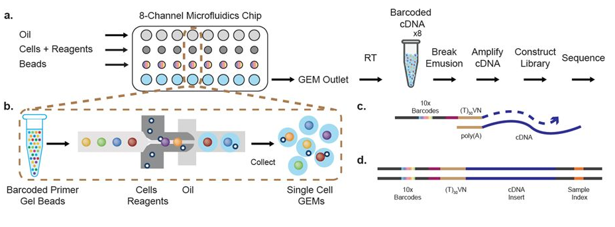
From bulk to single cell sequencing
Recent advances in NGS and microfluidics technology have allowed sequencing of the transcriptome of single cells.
10X sequencing
Generally 10³-10⁵ cells sequenced – 10⁴-10⁵ reads/cell
Other methods (e.g. SmartSeq 2): ~10⁶ reads/cell
Notes:
<number>

Slide 21
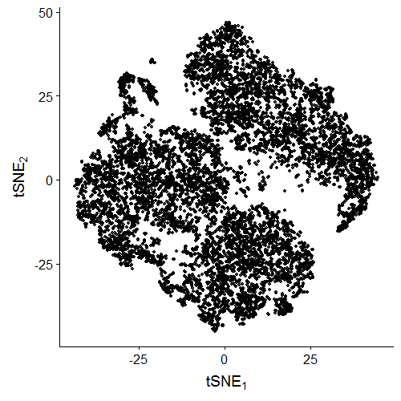
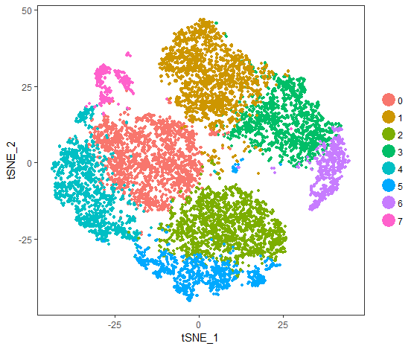
scRNAseq analysis
 | Cell 1 | Cell 2 | Cell 3 | … | Cell 12000
G 1 | 19 | 0 | 150 | … | 0
G 2 | 0 | 0 | 11 | … | 153
G 3 | 0 | 0 | 22 | … | 80
… | … | … | … | … | …
G 13000 | 15 | 81 | 0 | … | 22
Dimension reduction
(e.g. PCA, t-SNE, UMAP...)
Clustering
 | Dim 1 | Dim 2
C 1 | 2.34 | -0.35
C 2 | 3.15 | 1.87
… | … | …
C 12000 | -2.43 | -0.88
Fidanza et al., 2019

Slide 22
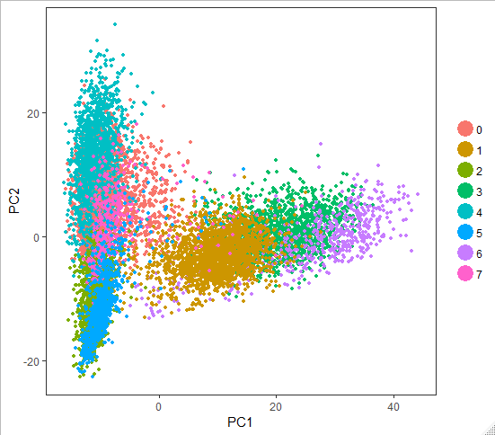
t-SNE dimension reduction
t-Distributed Stochastic Neighbour Embedding
Developed in 2008 by developed by Laurens van der Maaten and Geoffrey Hinton
Particularly suited to high dimensional data, such as that of scRNAseq experiments.
Contrary to PCA is not a linear projection, so it can capture non-linear relationships.
Newer, non-linear methods are being constantly developed, such as UMAP (Uniform Manifold Approximation and Projection for dimension reduction).
Fidanza et al., 2019

Slide 23
What are the issues?
An average file from a RNAseq experiment with ~50M reads is about 20 Gb
This has issues regarding
Computing power
Storage space
Costs
Data management plans are now required in most grants applications
Bioinformatics skills are required (although pre-existing analysis pipelines make things a lot easier than they used to be)
Notes:
<number>

Slide 24
Not only sequencing…
Other sources of big data exist including
Proteomics (and single-cell proteomics) experiments where MS is used to characterise the proteome
4D imaging experiments, high content screening, super-resolution methods
Many more will be coming!
Notes:
<number>

Slide 25
Conclusion
New technologies are changing the way we do biology
Large amount of data are now easy and cheap to generate…
…at the cost of not being able to understand what those data mean!
New skills and technologies will be needed ever more in the future!
Data analysis
Machine learning
Data visualization
…
Notes:
<number>

